Slide 1
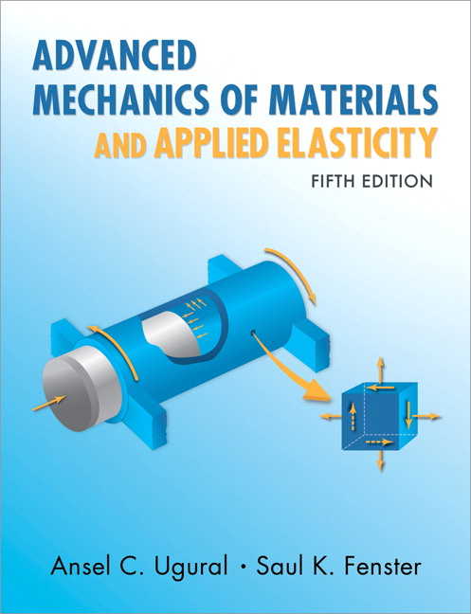
Advanced Mechanics
(Final Review Lecture)
ANNOUNCE / BUSINESS
HW Extra (due TODAY) Course feedback
HW 14 (due Th, 4/24)
PREVIOUS
Buckling
Plasticity Axial (assembly)
TODAY
Plasticity Bending
Plasticity Torsion

Slide 2
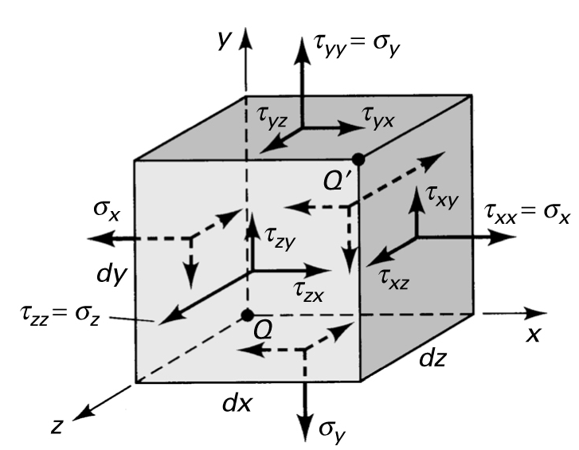
Stress Tensor
$$\left[τ\right]=\left[\begin{matrix}τ_{xx} & τ_{xy} & τ_{xz} \\ τ_{yx} & τ_{yy} & τ_{yz} \\ τ_{zx} & τ_{zy} & τ_{zz}\end{matrix}\right]$$
=$\left[\begin{matrix}σ_{x} & τ_{xy} & τ_{xz} \\ τ_{yx} & σ_{y} & τ_{yz} \\ τ_{zx} & τ_{zy} & σ_{z}\end{matrix}\right]$
Note correspondence between diagram and matrix – stress is a tensor, not a matrix (but it can be represented as a matrix and obeys rules of linear algebra)
A tensor is similar to a vector … both are a collection of numbers having physical meaning (a vector is actually a 1st order tensor; stress is a 2nd order tensor)
9 components of stress tensor (6 unique because this tensor is symmetric)
3 normal, 3 shear (opposing shear stresses equivalent by sum of moments … conservation of angular momentum)
Defining stress state is equivalent to defining components of stress tensor
Indicial notation (Einstein summation convention): τ_{ij}

Slide 3
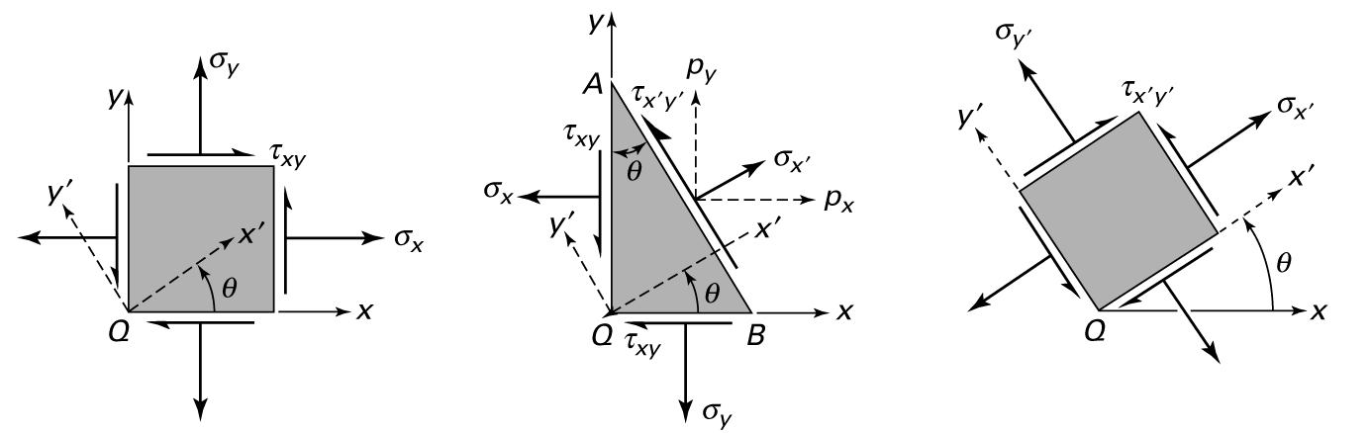


Stress Transformation – Plane Stress
(note that $p_{i}$ are stresses here, but balance law is applied to force)
Remember: Stress does not change during transformation, but its components change in the different coordinate system
Notes:
p, sigma, and tau are all stresses here, but equilibrium requires equality of force, so areas are also considered; hence, the first set of equations between p and sig and tau
These are the equations that define Mohr’s Circle

Slide 4



Stress Transformation – 3-D

Slide 5
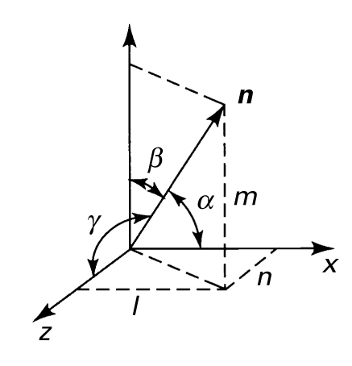


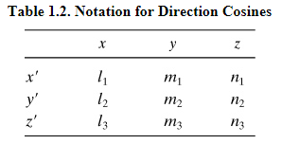
y
Direction Cosines
$$[M]=\left[\begin{matrix}x^{′}∙x & x^{′}∙y & x^{′}∙z \\ y^{′}∙x & y^{′}∙y & y^{′}∙z \\ z^{′}∙x & z^{′}∙y & z^{′}∙z\end{matrix}\right]$$

Slide 6
Linear Algebra Approach
Can again avoid long equations … with linear algebra
With direction cosine matrix (transformation matrix M), a vector transforms as
A second order tensor transforms as
Let’s consider an example
$$a^{′}=Ma$$
$$τ^{′}=MτM^{T}$$
* Note that Eqn’s 1.29 in the text have incorrectly switched the transform order
(or $T^{′}=MTM^{T}$ if we use $T$ to represent the stress tensor)

Slide 7
Principal Stresses - Example
Now find the eigenvectors …
… plug each eigenvalue back into the equation and solve for the vector associated with each
For λ₁ = 14.5,
$$Tv=λv → \left(T−Iλ\right)v=0$$
$$\left[\begin{matrix}12−14.5 & 0 & 6 \\ 0 & 4−14.5 & 0 \\ 6 & 0 & 0−14.5\end{matrix}\right]\left[\begin{matrix}v_{1} \\ v_{2} \\ v_{3}\end{matrix}\right]=\left[\begin{matrix}−2.5 & 0 & 6 \\ 0 & −10.5 & 0 \\ 6 & 0 & −14.5\end{matrix}\right]\left[\begin{matrix}v_{1} \\ v_{2} \\ v_{3}\end{matrix}\right]=\left[\begin{matrix}0 \\ 0 \\ 0\end{matrix}\right]$$
$$−{2.5v}_{1}+6v_{3}=0 → v_{1}=2.4v_{3}$$
$${−10.5v}_{2}=0 → v_{2}=0$$
$$6v_{1}−14.5v_{3}=0 → v_{1}={2.4v}_{3}$$

Slide 8
Principal Stresses
Determine the particular surface normal n that maximizes the normal stress $$ and zeros the shear stresses $$. In this case,
In other words… we seek a coordinate system in which the stress tensor is diagonalized.
Note that this is just one surface of 3
t, traction vector
σ, normal stress
$$t=Tn=σn$$
cutting plane
τ,
shear stress
n, surface unit
normal vector

Slide 9
Two especially important things
Principal stresses (i.e. eigenvalues) of a stress tensor
Rotational Invariants of a stress tensor

Slide 10
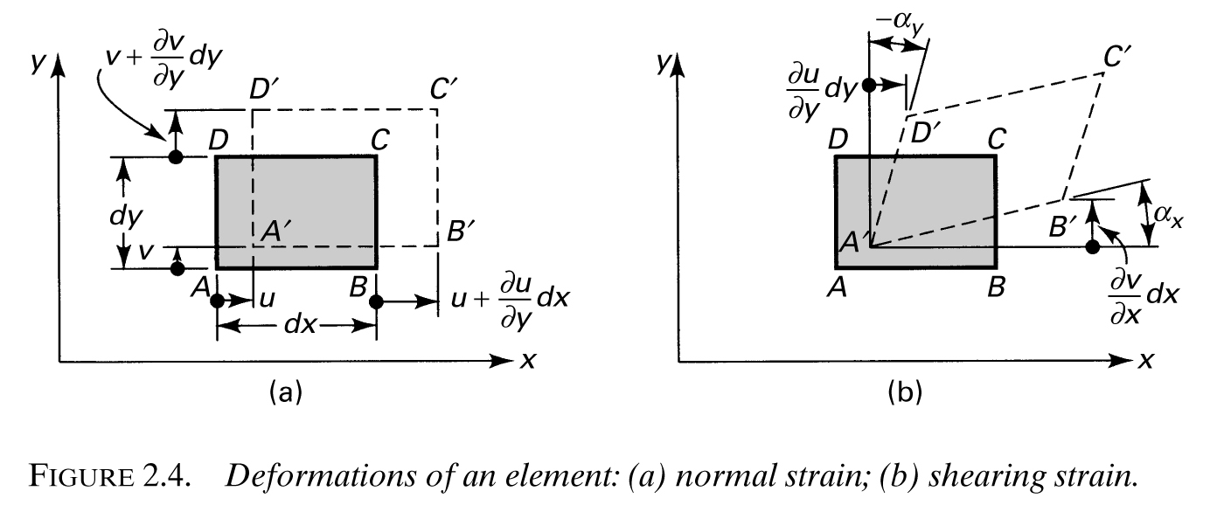


Strain – Infinitesimal
$$\frac{∂u}{∂x}$$
Can calculate strain directly from disp
$$u=u(x,y,z)$$
$$v=v(x,y,z)$$
$$w=w(x,y,z)$$

Slide 11



Strain – 3D
Like stress, strain is also a symmetric second-order tensor
But only when we use tensorial, instead of engineering, shear strains
This allows compact expression of the infinitesimal strain-displacement equations using index notation.

Slide 12
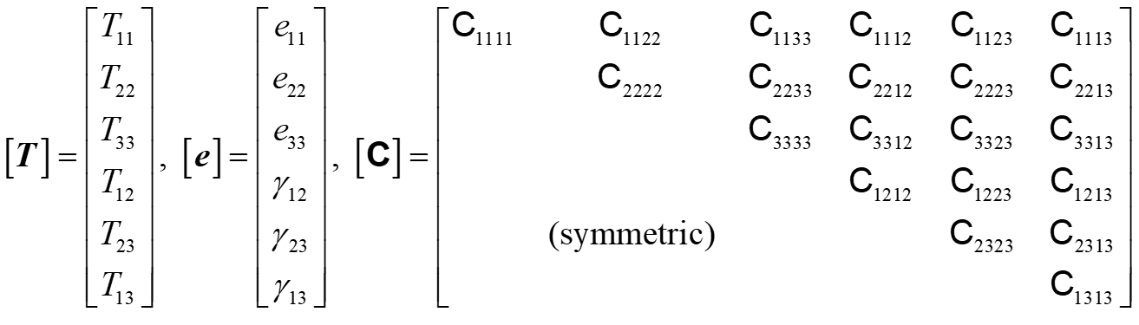
Generalized Hooke’s Law
$$σ=σ\left(ε\right)=T(e)$$
$$T=Ce or e= C^{−1}T$$
C is a 4th order tensor (3x3x3x3 = 81 components, but due to symmetries in stress and strain and strain energy considerations, it can be reduced to 21 unique components)
We can write it as a 6x6 using “Voight notation”
Voigt notation takes advantage of the fact that stress and strain both have 6 unique components; now our 2nd order tensors are represented as 6x1 vectors.

Slide 13
Maximum Shear Stress Theory
aka Tresca yield criterion
Origin in observation that ductile materials yield as a result of shear along slip planes
Theory: yielding will begin when max shear stress exceeds max shear stress at yield in simple tension (again obtained by experiment)
from Mohr’s Circle: $τ_{Y}=\frac{σ_{Y}}{2}$ less than ${τ_{Y}≈0.6σ}_{Y}$ (conservative)
so expect yielding when: $τ_{max}=\frac{1}{2}(σ_{1}−σ_{3})≥\frac{σ_{Y}}{2}$ OR $(σ_{1}−σ_{3})≥σ_{Y}$
Consider two cases of multiaxial loading
Make sure the principal stresses above are those defined in 3D

Slide 14

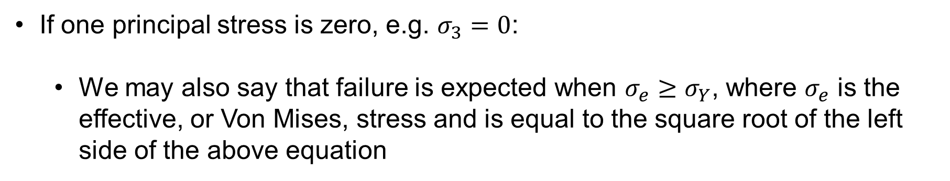
Maximum Distortion Energy Theory
aka Von Mises Theory
Theory: yielding occurs when the distortion energy per unit volume becomes equal to that associated with yielding in a simple tension test
Therefore, failure occurs when
or
If one principal stress is zero, e.g. $σ_{3}=0$:
We may also say that failure is expected when $σ_{e}≥σ_{Y}$, where $σ_{e}$ is the effective, or Von Mises, stress and is equal to the square root of the left side of the above equation

Slide 15
Empirical Comparison
Note:
Tresca is conservative
Von Mises is accurate
Dowling

Slide 16

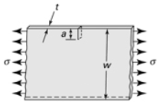
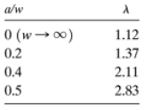

Fracture Mechanics
Stress intensity factor
where $σ$ is nominal normal stress, $λ$ is a geometry factor (like a stress concentration factor), and $a$ is crack length; note units of $K$ are $MPa\sqrt{m}$
Fracture predicted when $K=K_{IC}=K_{C}$ , the fracture toughness
$λ$ is found from tables (provided in textbook) for specific cases, e.g. for a long plate having an edge crack under tension …
2
Only valid when , ensuring plane strain.
Notes:
Note that some geometries / tables refer to cracks that have a total length of 2a. Solve the problem consistent with this designation, meaning that for a central crack, a in the K equation is half the total length.

Slide 17
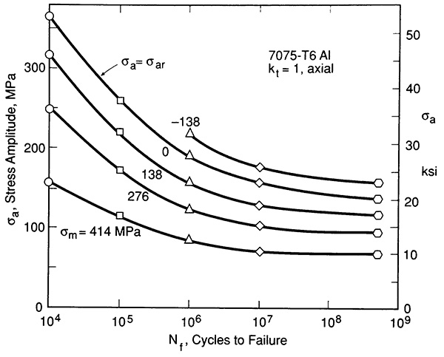
Fatigue Life
Mean stress influences S-N behavior
$${(σ}_{cr})$$
(Dowling, Fig 9.25)

Slide 18
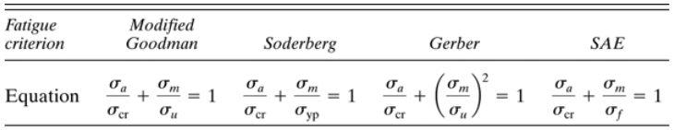
Fatigue Failure Criteria
Fatigue criteria provide a way to determine the completely reversed ($σ_{cr}$) stress, or fatigue strength, for given material properties and combinations of alternating and mean stresses.
(not as conservative)
(equivalent to Modified Goodman for brittle materials)
good for steel
Notes:
We see that each equation relates the applied mean and alternating stresses to a completely reversed alternating stress and a failure strength parameter

Slide 19
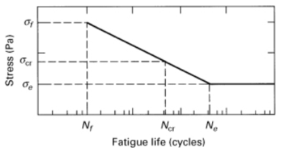


Fatigue
Once we know the fatigue strength for a given loading combination, we can determine the number of cycles to failure
$$\frac{σ_{a}}{σ_{cr}}+\frac{σ_{m}}{σ_{u}}=1$$

Slide 20
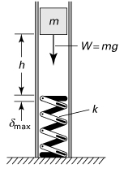


Impact / Dynamic Loading
Consider a mass dropped onto a spring with stiffness $k$
Using Conservation of Energy (?!)
Define impact factor $K$
Consider extreme case $h=0$

Slide 21


Theory of Elasticity
Note the similarity between the equations for plane strain and plane stress
In the absence of body forces, they are the same!
For identical geometry and loading conditions, the resulting stress distribution is independent of material properties … important to photoelasticity

Slide 22
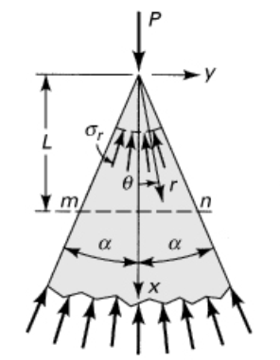





Concentrated Loads
Compression of a (semi-infinite) wedge
Stress function:
Stress expressions (from Airy):
Boundary conditions:
Solution:
Local plasticity for true point, so not valid at point of contact

Slide 23
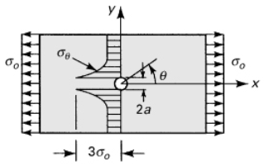

Stress Concentration
nominal stress?
Notes on nominal stress
Value of stress if stress concentration was not present
Typically use reduced cross section for calculation (check reference used); often different from “far-field” stress
Equation valid as long as max stress does not exceed yield. For ductile materials, the stress concentration is insignificant where max stress exceeds yield in static loading, but it can’t be ignored in dynamic or thermal loading.

Slide 24
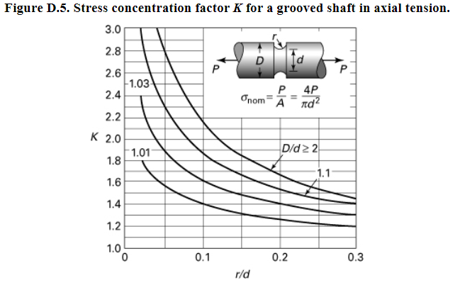

Slide 25
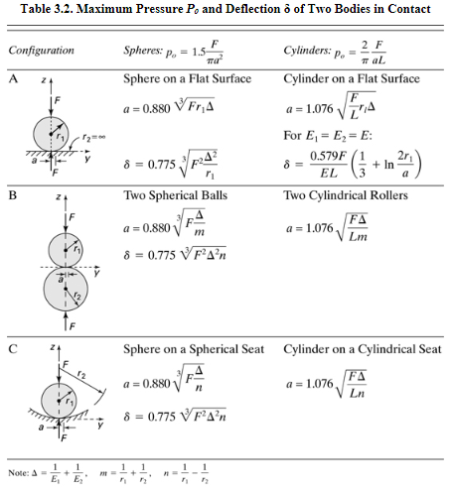
$$m$$
* note that soft object dominates results for contact area and displacement:
$Δ=\frac{1}{E_{1}}+\frac{1}{E_{2}}=\frac{E_{1}+E_{2}}{E_{1}E_{2}}$. If $E_{1}≫E_{2}$, $Δ≈\frac{E_{1}}{E_{1}E_{2}}=\frac{1}{E_{2}}$
* all formulae in this table assume $ν=0.3$

Slide 26
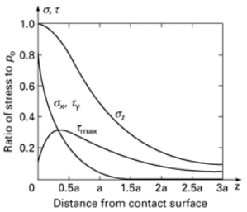
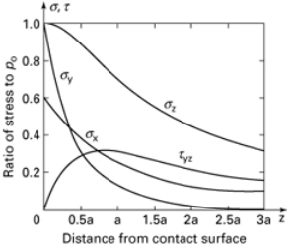
Contact Stress Distribution
2 spheres
2 parallel cylinders
σ_{y}
Normal stresses decrease with distance from surface (eq’ns in text)
Shear stress in x-y plane is zero (for spheres), but $τ_{max}(=τ_{yz}=τ_{xz})$ increases briefly, then decreases

Slide 27
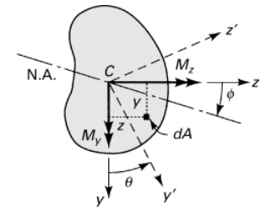


Asymmetric Bending (pure bending)
Equation of neutral axis

Slide 28

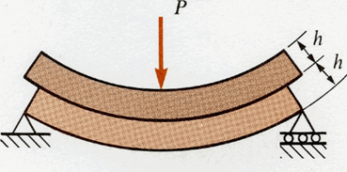

Shear Stress
Often ignored during failure analysis since it is negligible compared to normal stress in typical beams; becomes more important for short, stubby beams
Plays important role in constraining bending of long beams
Notes:
right middle: show that for distributed load case application of stacked beam scenario, a beam with height 2h has ¼ the deflection of two beams with height h stacked on top of each other

Slide 29
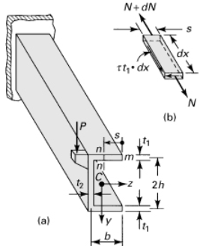
Shear Center
Independent of magnitude and direction of force
2 axes of symmetry: located at centroid
1 axis of symmetry: on axis of symmetry
May be located outside the cross section of beam
Not so important in solid or thick-walled beams since they have high resistance to torsion; more important in thin-walled beams

Slide 30
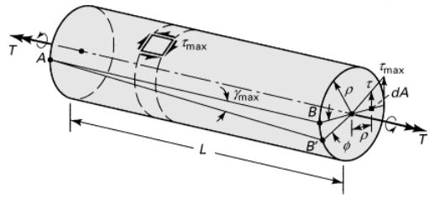
Angle of Twist
Assumptions:
Linear elastic
Homogeneous
Cross-sections remain perpendicular to axis

Slide 31
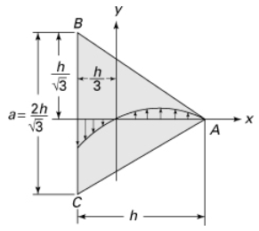
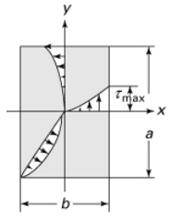
Solutions
max
zero!

Slide 32
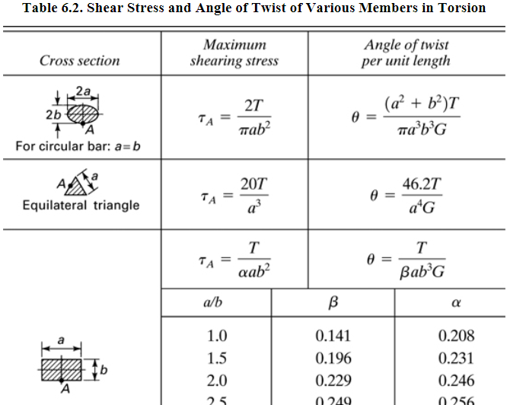
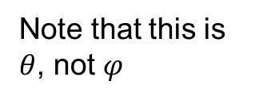
Solutions
Note that this is $θ$, not $φ$

Slide 33
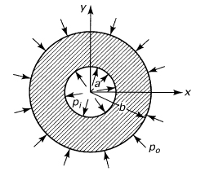
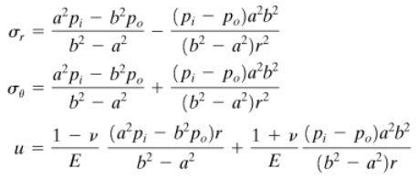


Stress in Thick-Walled Cylinders
What if ${\text{s}}_{z}≠0$? If closed ends, the above stress equations (but not $u$) are the same, but equilibrium in $z$-direction requires:
$$σ_{z}$$
$$p_{i}$$
$$p_{o}$$

Slide 34
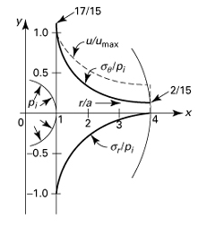
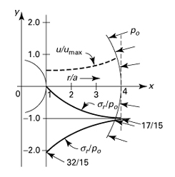

Thick-Walled Pressure Vessels
Note that max tangential (circumferential) stress acts at inner surface in both cases … not always true if pressure acts on both surfaces (see next slide)
Where does maximum shear stress occur?

Slide 35


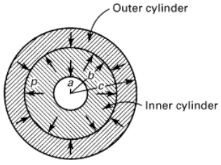


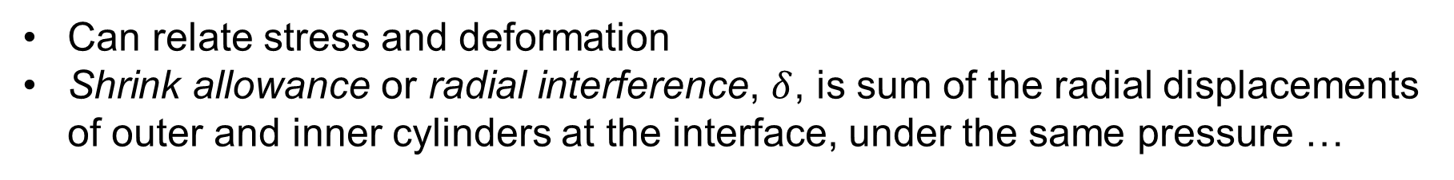
Compound Cylinders: Press or Shrink Fits
Can relate stress and deformation
Shrink allowance or radial interference, $δ$, is sum of the radial displacements of outer and inner cylinders at the interface, under the same pressure …
+
If materials are the same,

Slide 36
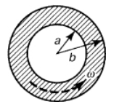
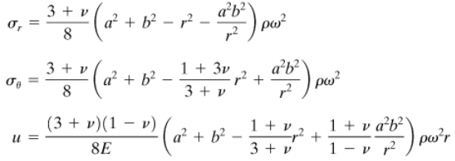
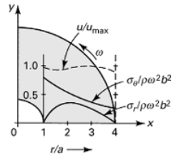

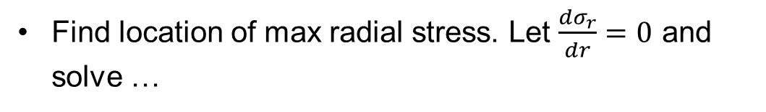

Annular Disk
Boundary conditions:
Then,
Find location of max radial stress. Let $\frac{{dσ}_{r}}{dr}=0$ and solve …
(occurs at $r=\sqrt{ab}$)

Slide 37
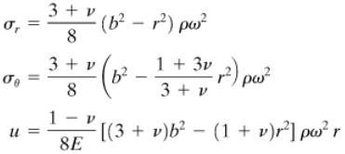
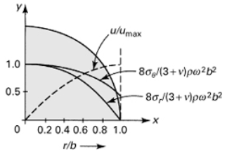
Solid Disk
Boundary conditions:
Then,
* If small hole in center of solid disk, circ stress doubles!

Slide 38



Castigliano’s Theorem
Derived approach to solve for deflections; can similarly find the slope at a point of interest (as long as a couple $C$ is applied there)
Strain energy is a function of axial load, moment, transverse load, and torque
Since $P_{i}$ and $C_{i}$ are not functions of $x$, we can move the derivative inside the integrals …

Slide 39
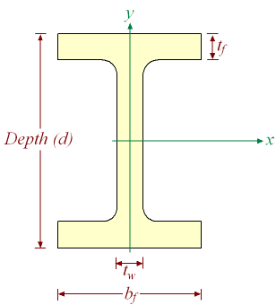
Dummy Loads
Example: Find deflection at $D$ in a beam with a wide-flange ($W10x15$) cross-section. Use $E=29x{10}^{6} psi$ and $I_{x}=69.9 {in}^{4}$.
nominal
depth, $d$
weight/length
$lb/ft$
$$ω=1.8 kip/ft$$
$$A$$
$$B$$
$$D$$
$$7.5’$$
$$12’$$

Slide 40
Indeterminate Structures
Castigliano’s can also be used to determine forces in indeterminate structures, knowing that displacement at the constraints has to be zero.
Approach: “Remove” one constraint and replace it with an unknown force (knowing the deflection is zero there). In our application of this method thus far, we have known the force but not the deflection. With this approach, we now don’t know the force, but we do know the deflection. There is still just one unknown.

Slide 41
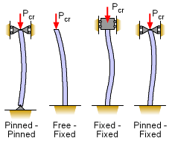
Effective Length
$$P_{cr}=\frac{π^{2}EI}{L_{e}^{2}}$$
$L_{e}=L$,
$=2L$,
$=L/2$,
$$=0.7L$$

Slide 42
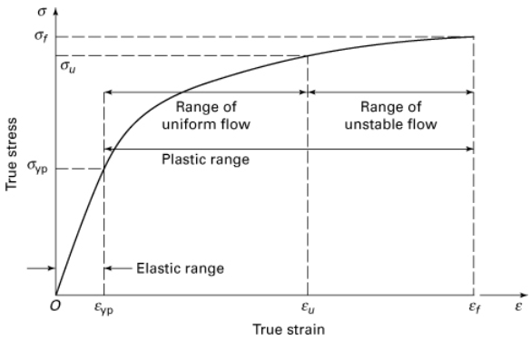
Plasticity
Inelastic material behavior – permanent distortion upon complete unloading (will focus on this in upcoming lectures)
Equations of equilibrium, conditions of compatibility, and strain-displacement relations still apply, but we need new stress-strain relationships

Slide 43
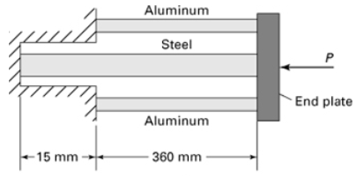
Residual Stress
Example: The figure shows a steel bar of $750 {mm}^{2}$ cross-sectional area placed between two aluminum bars, each of ${500 mm}^{2}$ cross-sectional area. The ends of the bars are attached to a rigid support on one side and a rigid thick plate on the other. Calculate the residual stress for the case in which load $P$ is increased from zero to the ultimate (fully plastic; assume elastic, perfectly-plastic material) load and then removed.
Given: $E_{s}=210 GPa$, $σ_{yp,s}=240 MPa$, $E_{a}=70 GPa$, and $σ_{yp,a}=320 MPa$.
I solved this opposite from the text!

Slide 44
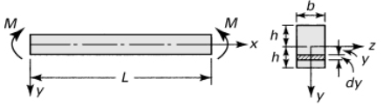
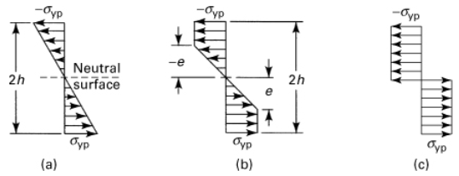

Plasticity in Bending
Consider elastic, perfectly-plastic behavior (could also consider work hardening material) under pure bending

Slide 45


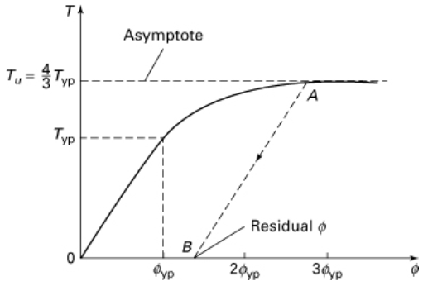
Elastic-Plastic Torsion

